Slide 1
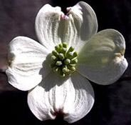

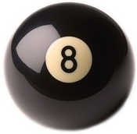
Ad Quadratum Symmetry
4 – 8 - 12
Page 49
Michael S. Schneider
www.constructingtheuniverse.com

Slide 2
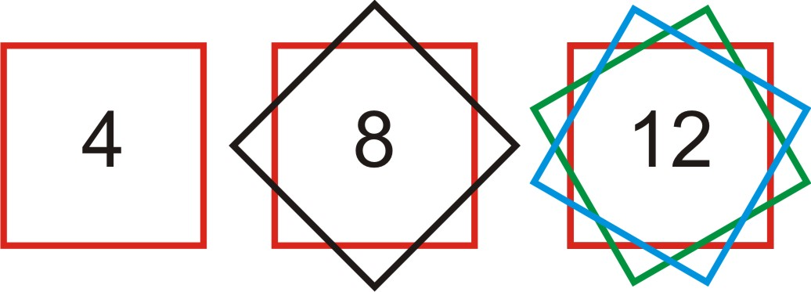
To understand all the shapes in the universe, you only have to know about the numbers
1 2 3 4 5 6 7 8 9 10 11 12
The numbers 1-12
naturally form four groups
First Principles: 1, 2
Numbers of Structure: 3, 4, 6, 8, 12
Numbers of Life: 5, 10
Numbers of Mystery: 7, 9, 11
points
points
points
1 square
3 squares
2 squares

Slide 3
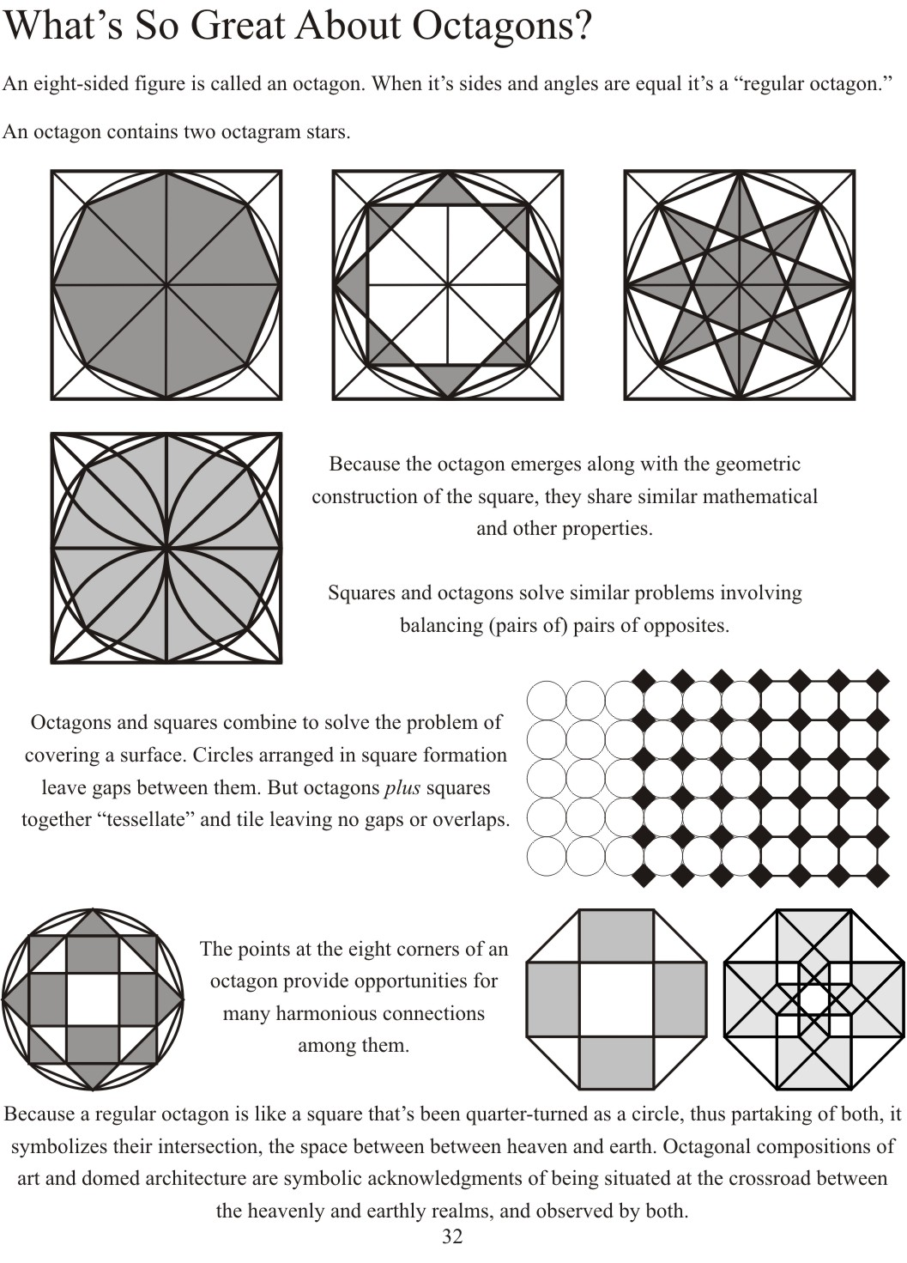
Page 50

Slide 4
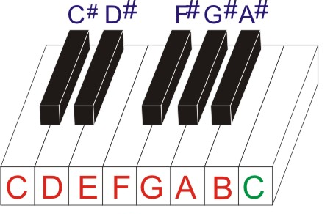

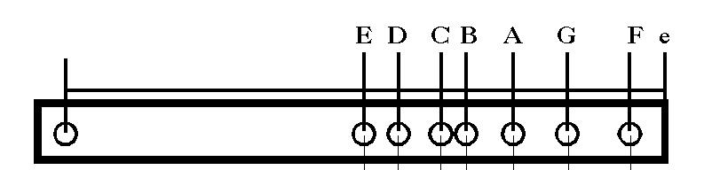
The 8 white keys
8 notes of the Musical Octave
The eighth note repeats the same note as the first
but at double the frequency
and half the wavelength.

Slide 5
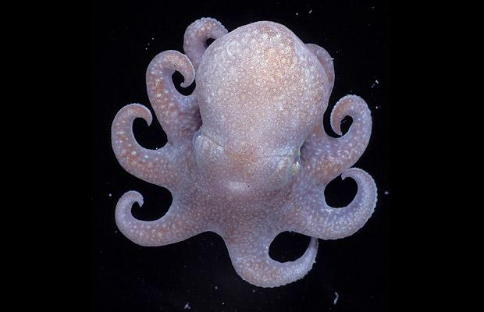
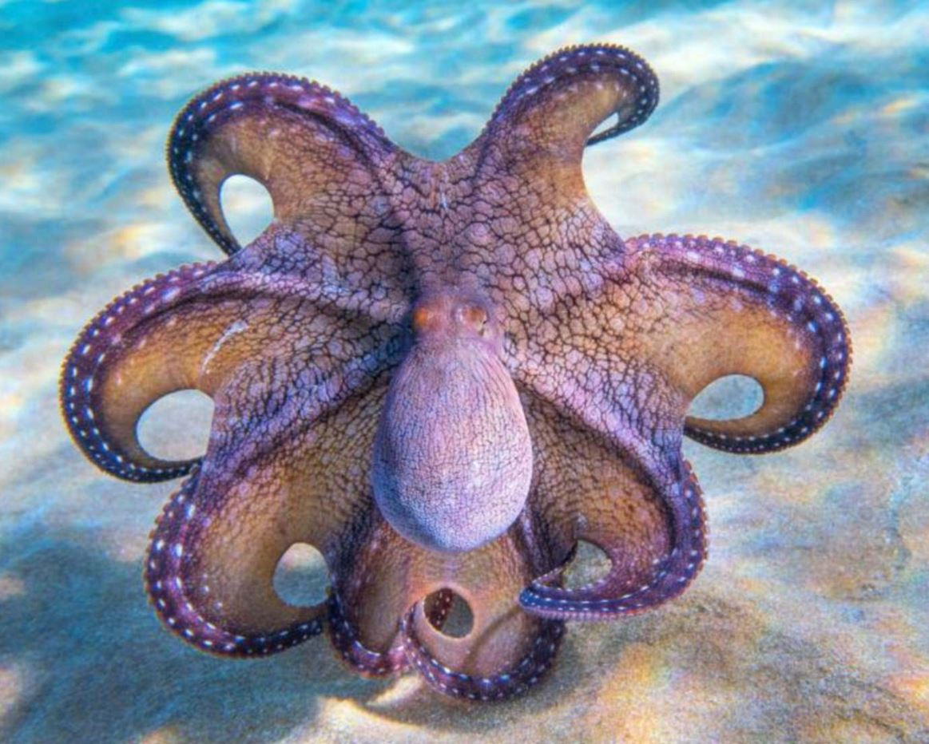
8
Octopus

Slide 6
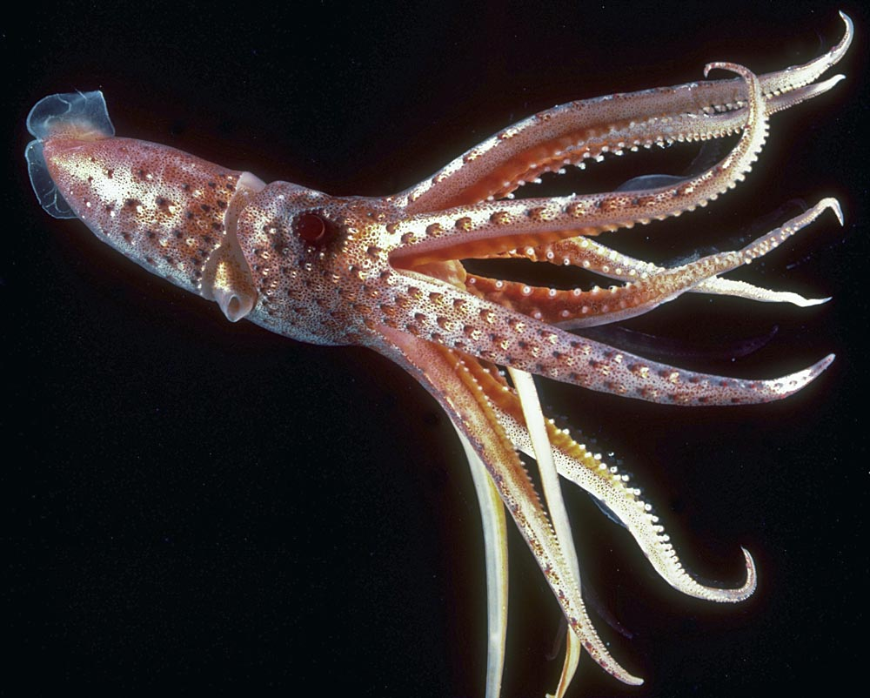

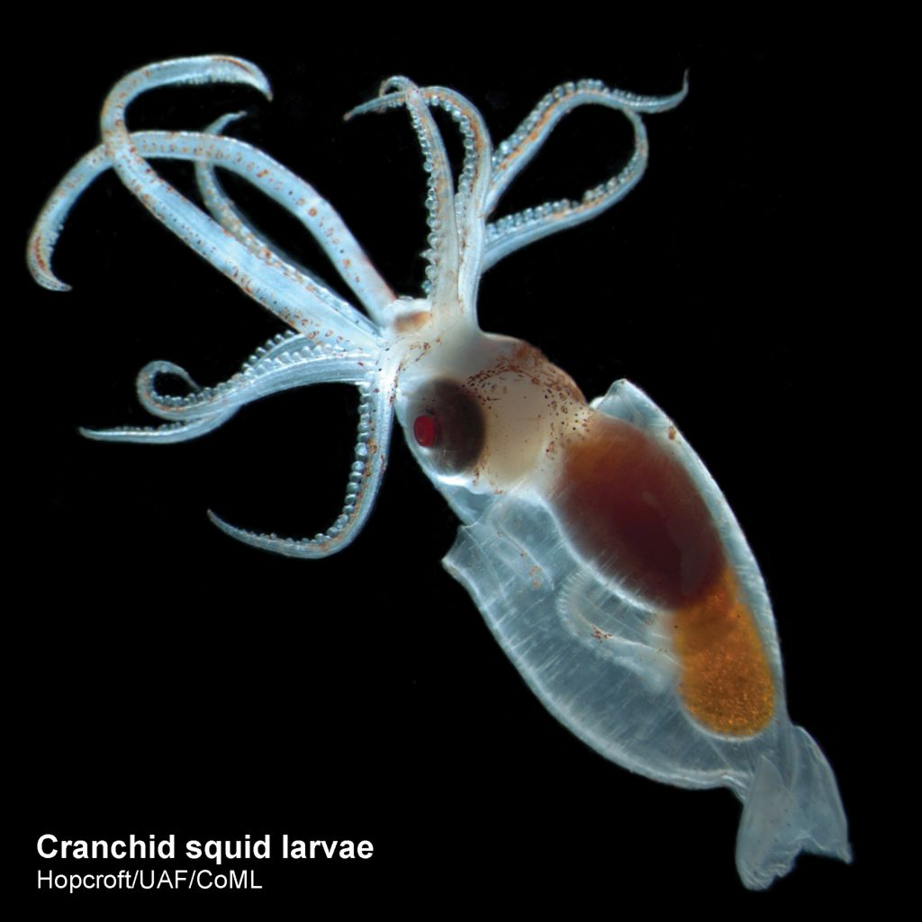
8 arms of a squid

Slide 7
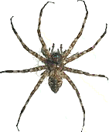
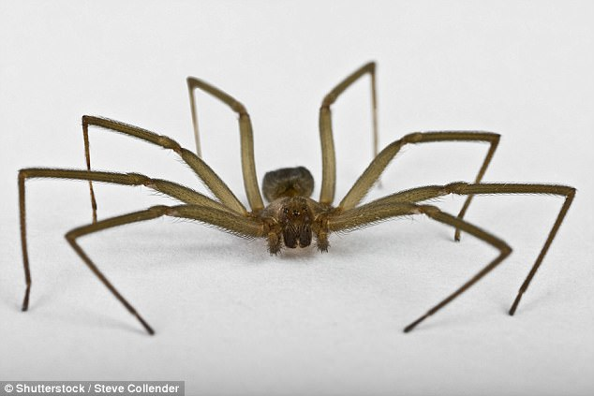
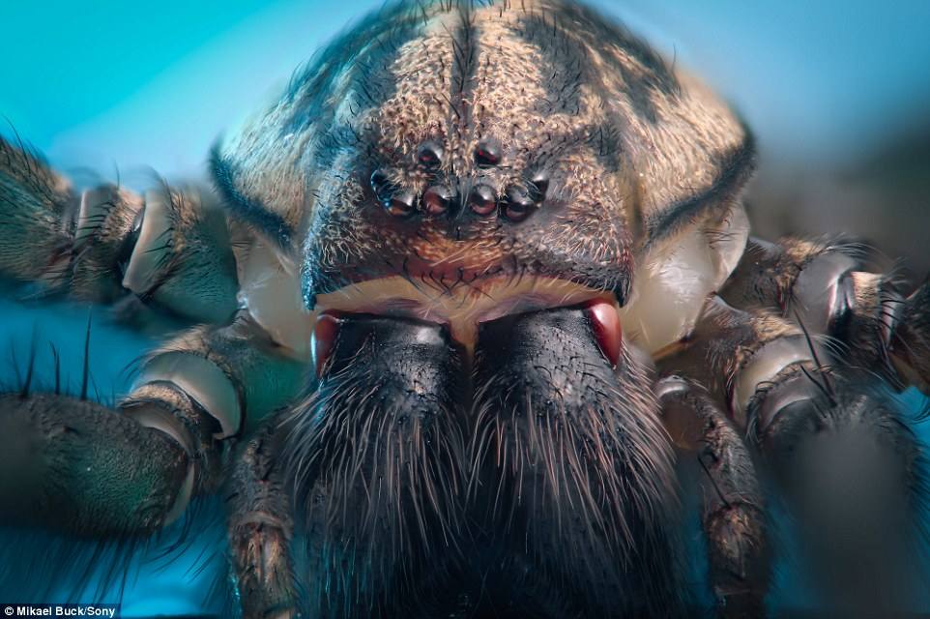
Arachnids
Spiders have 8 legs
Some spiders have 8 eyes!

Slide 8
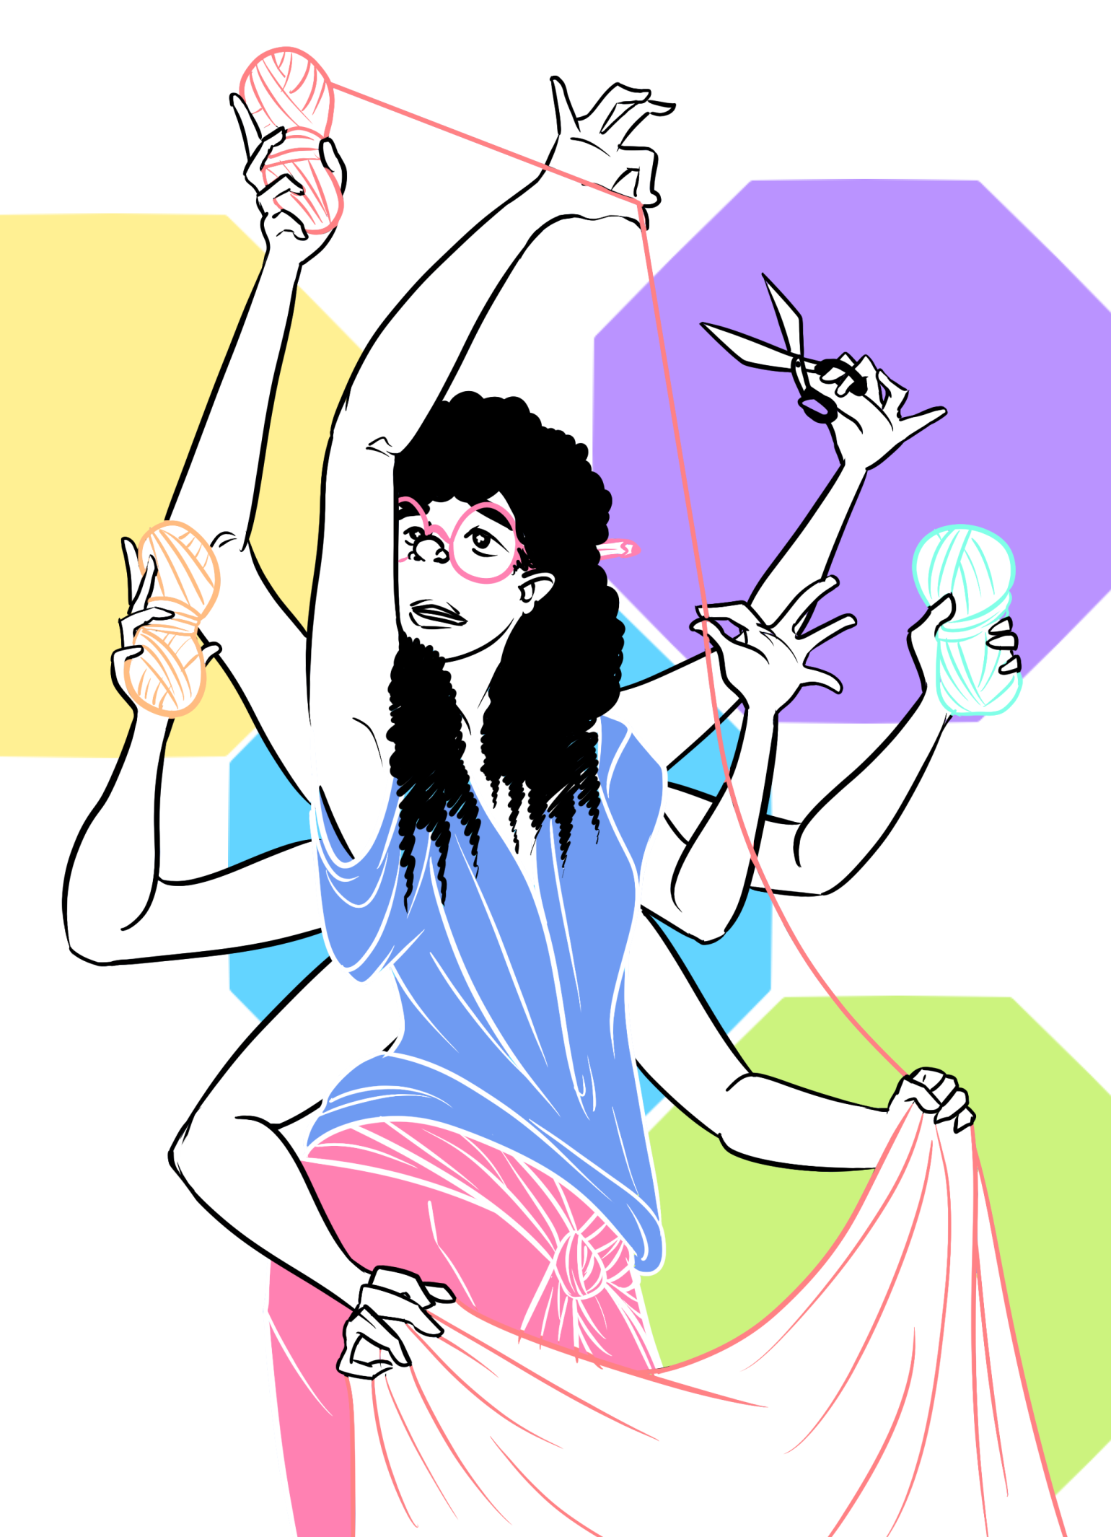
Arachne

Slide 9
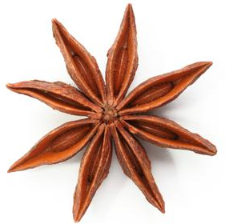
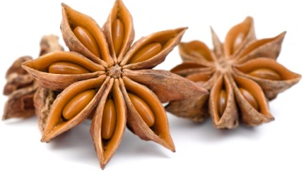
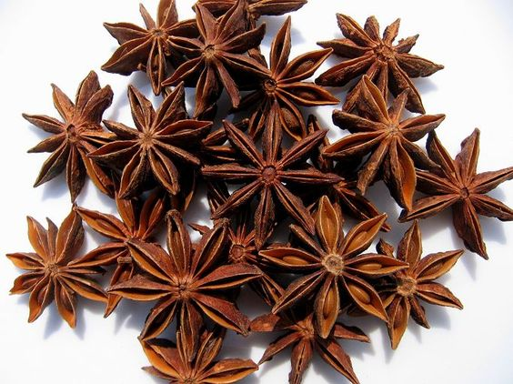
Star Anise
spice

Slide 10
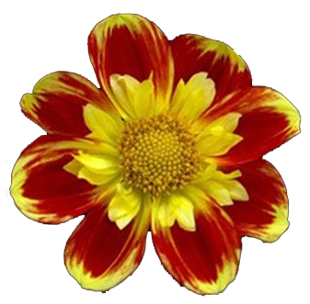

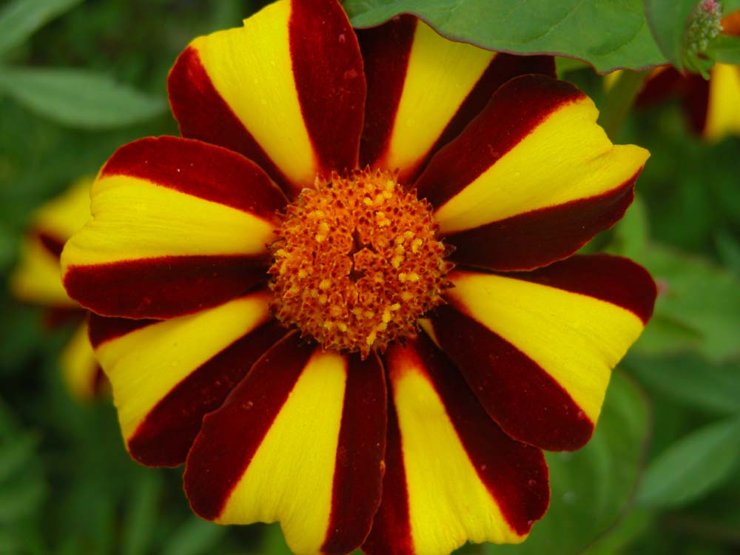

Slide 11
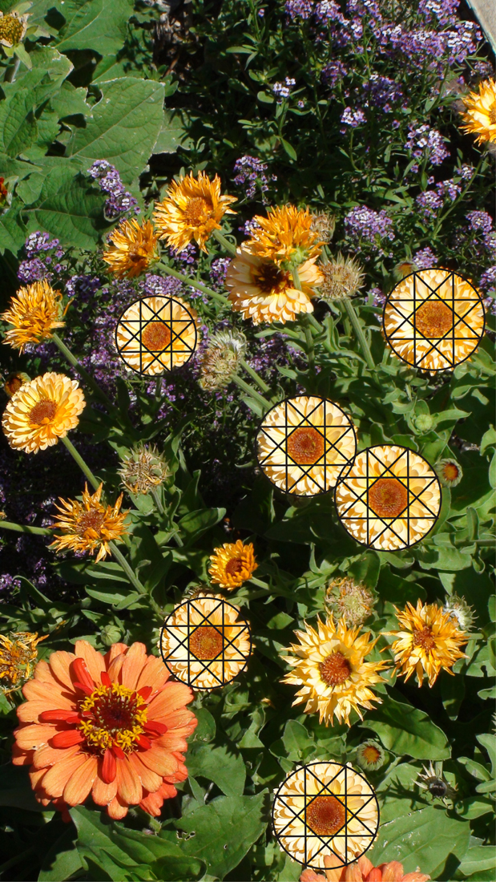
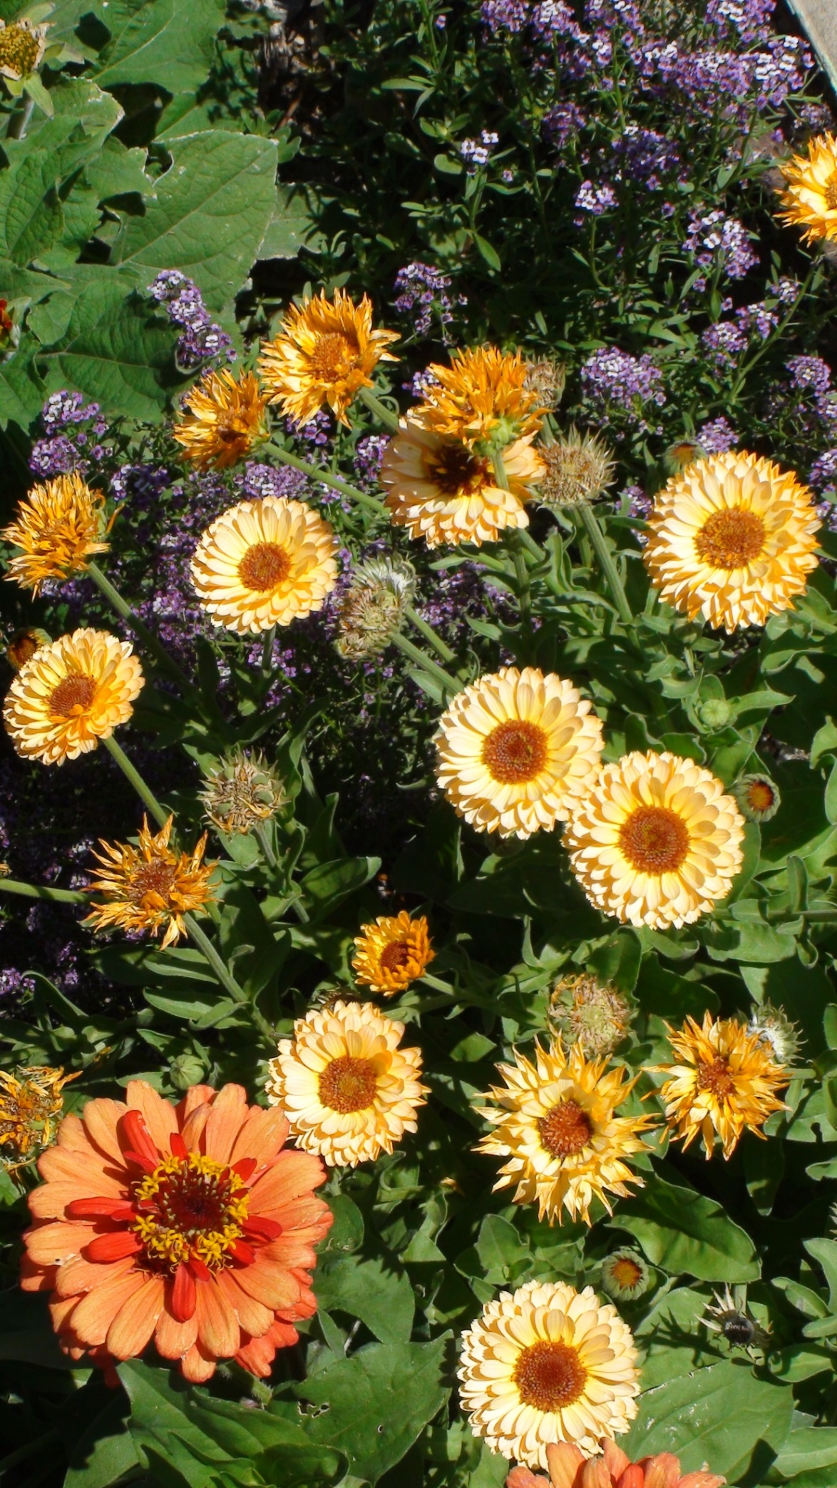

Slide 12
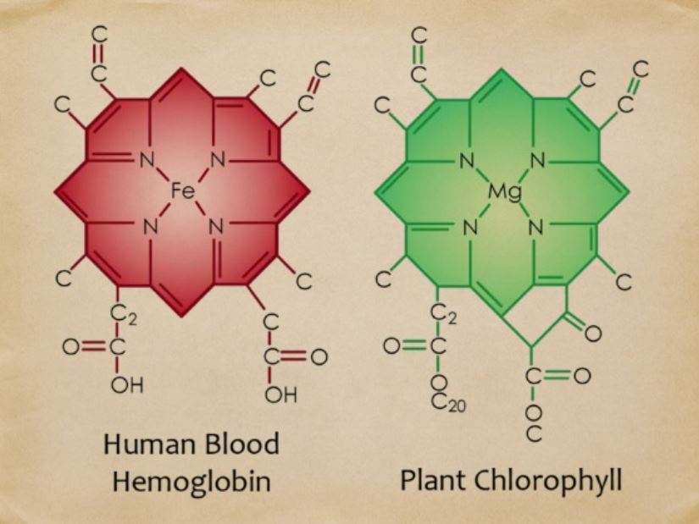

Slide 13
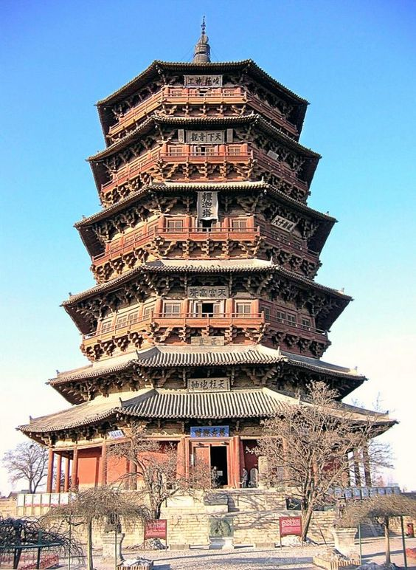
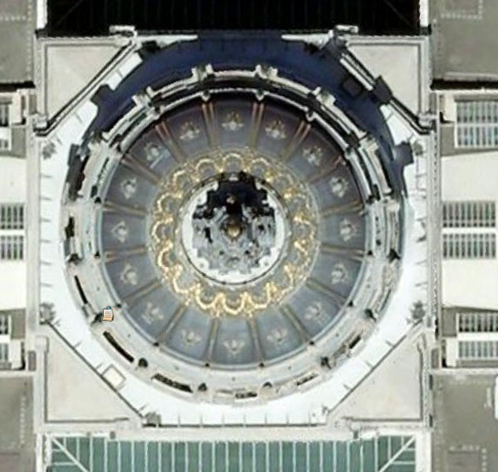
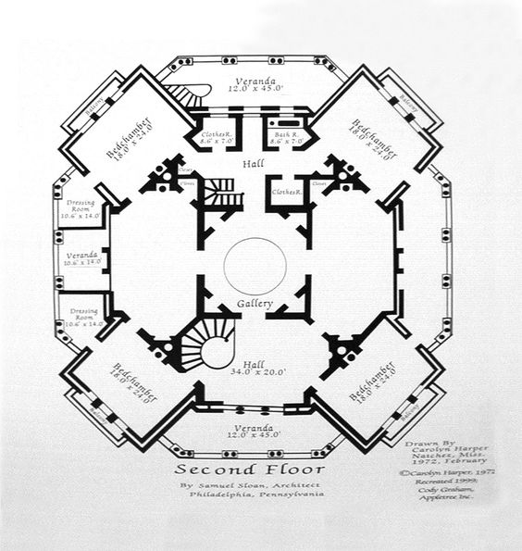
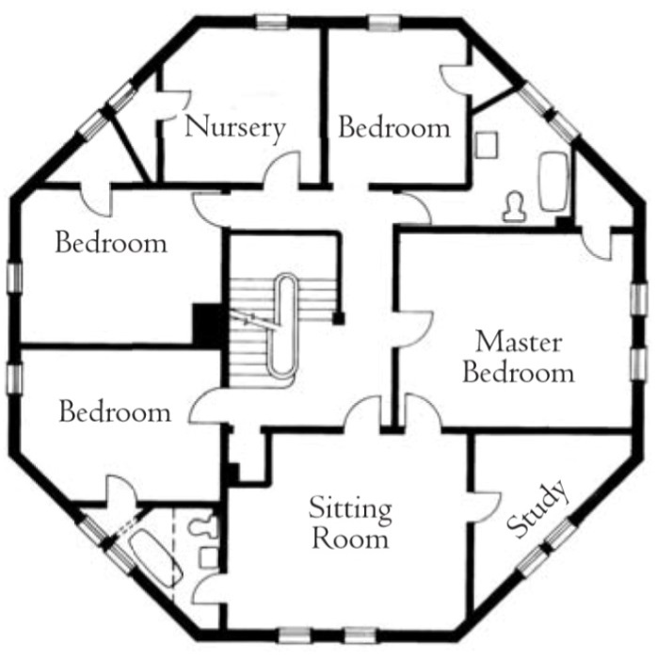
Octagonal Architecture
SF City Hall dome

Slide 14
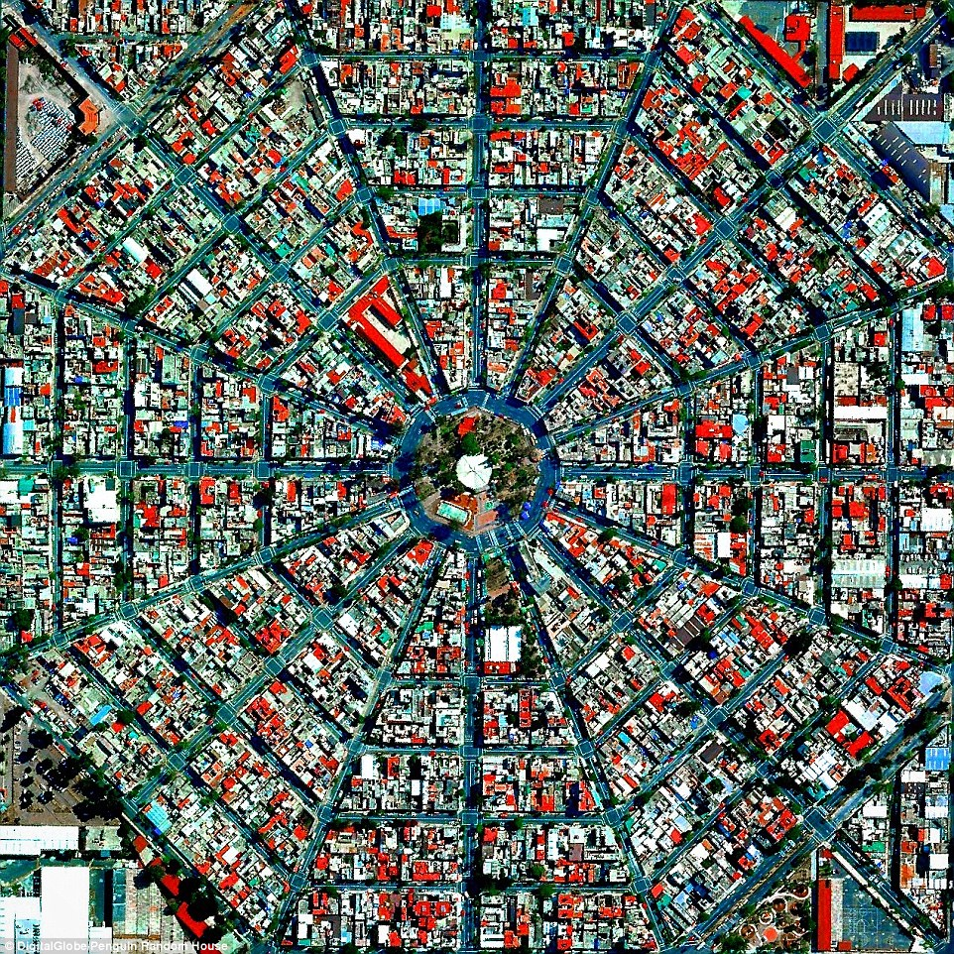
Plaza Del Ejecutivo Mexico City, Mexico

Slide 15
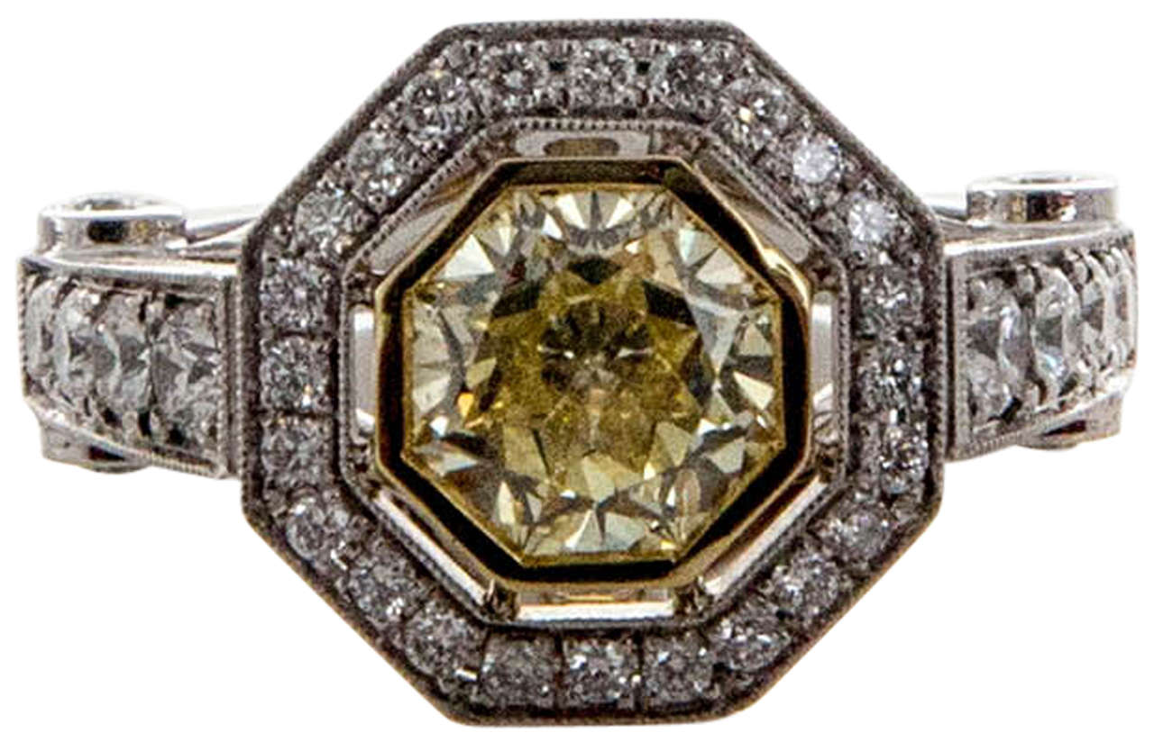
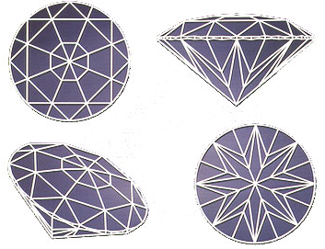
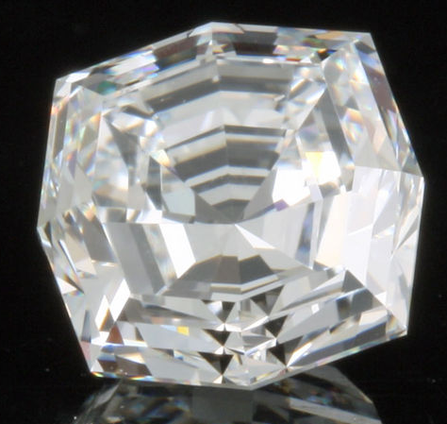
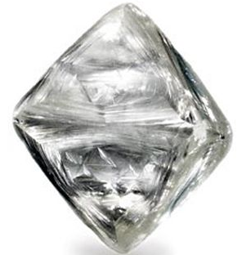
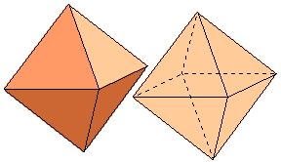
Diamonds are often cut as octagons
(it makes the most sparkle)
Diamond crystal
8-faced Octahedron

Slide 16
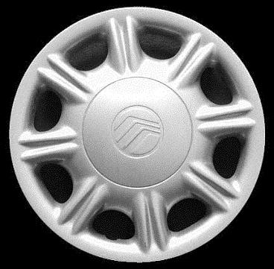
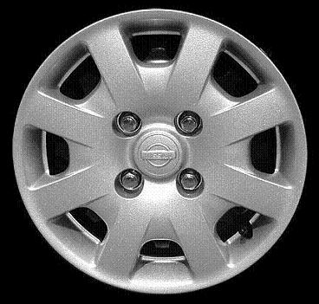

Slide 17
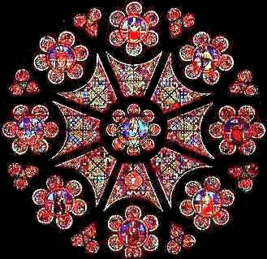
Design an octagonal Rose Window

Slide 18
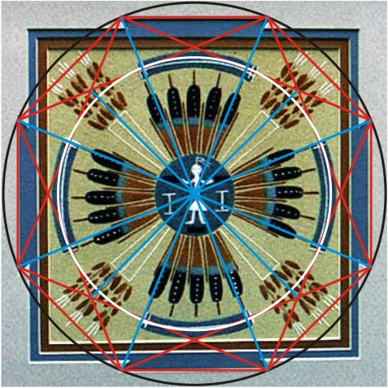
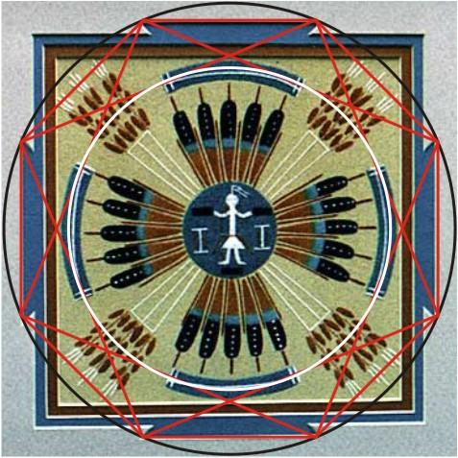
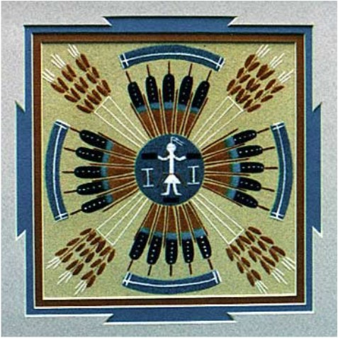
Page 53

Slide 19
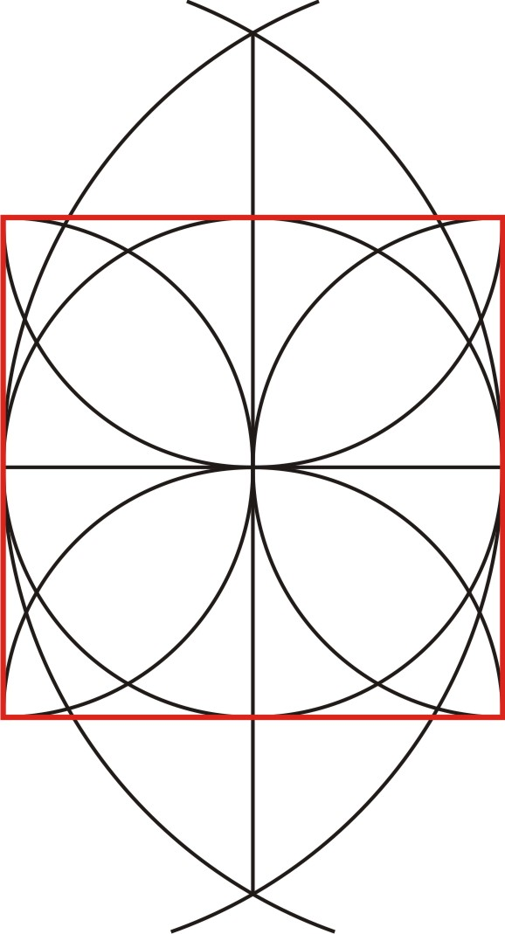
To find 8 points around the circle, start with a square:

Slide 20
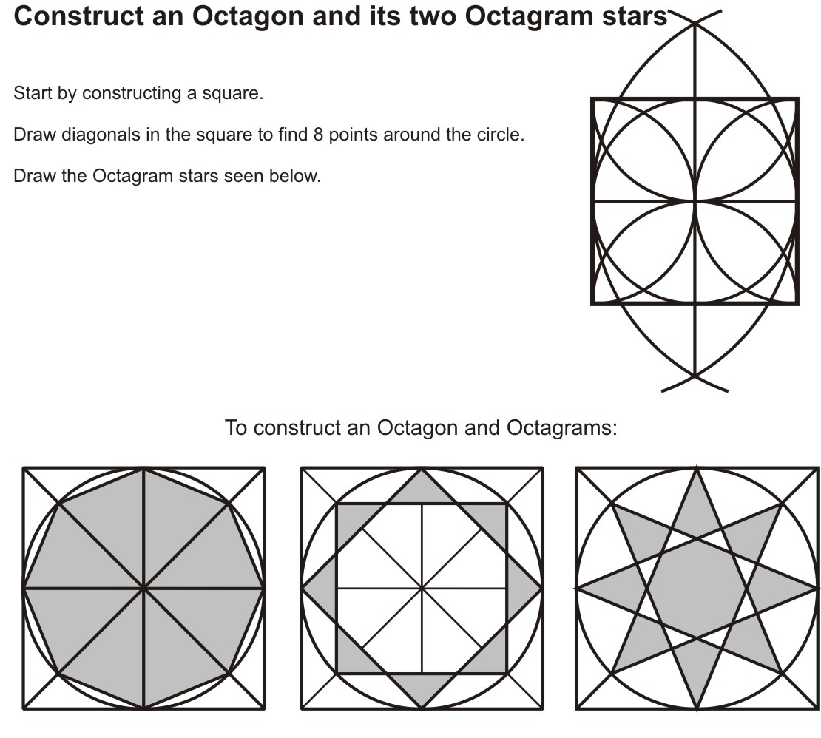
Page 51

Slide 21
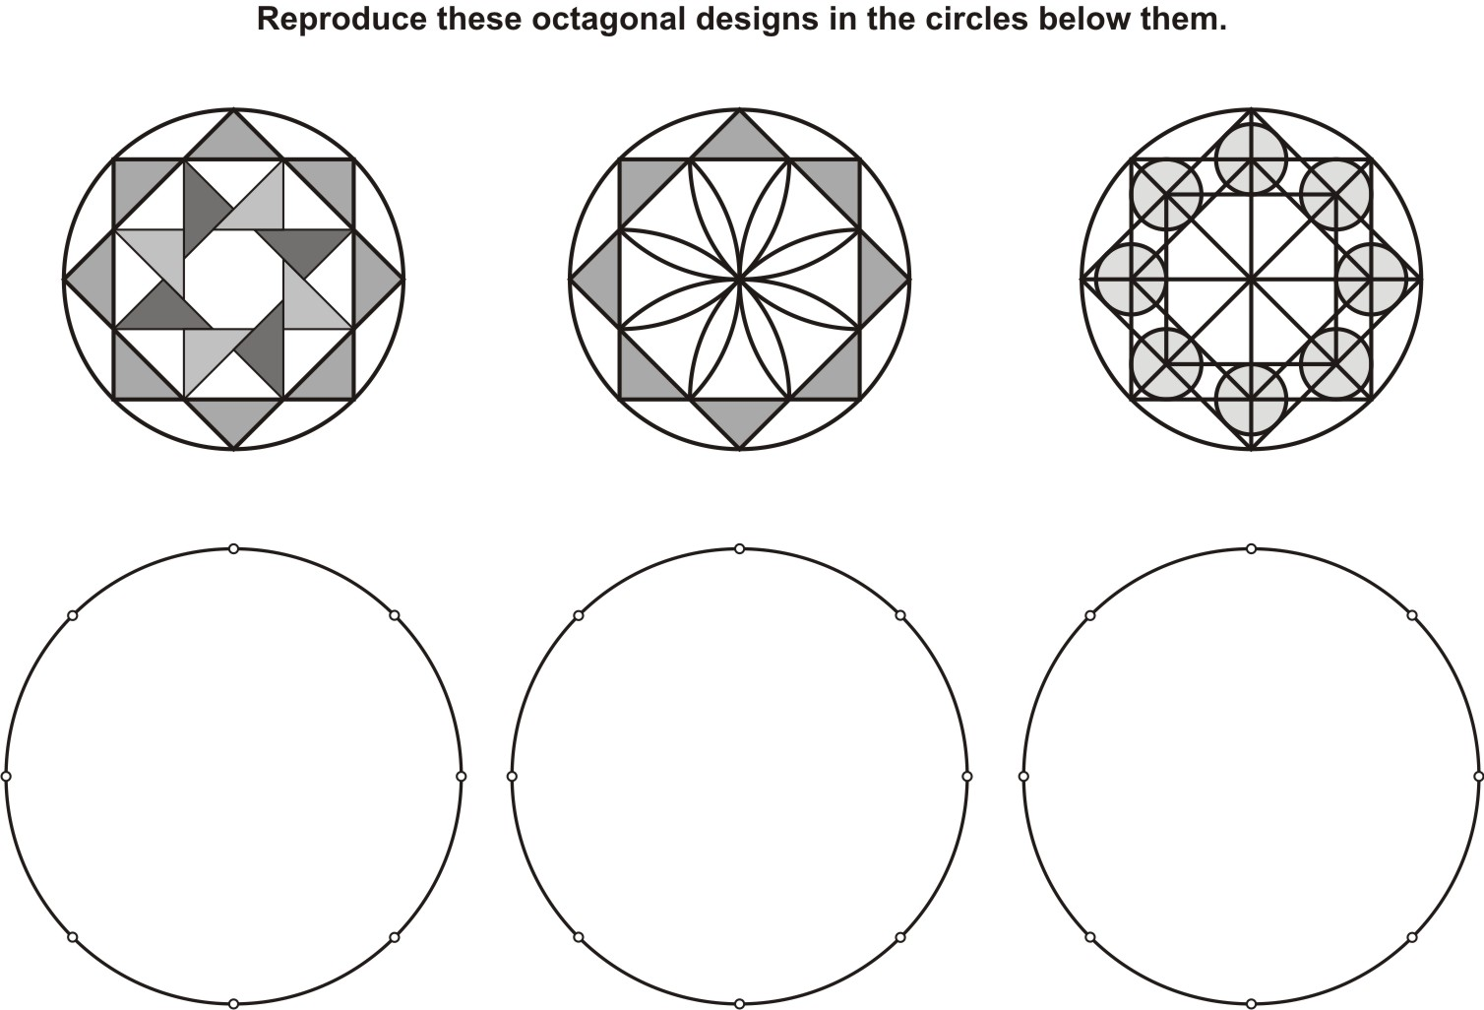
Page 52

Slide 22


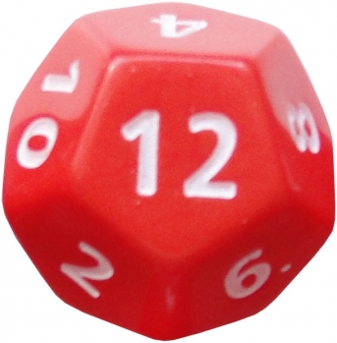
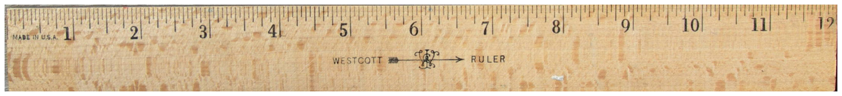
What’s so great about 12?
The ultimate “structure”

Slide 23
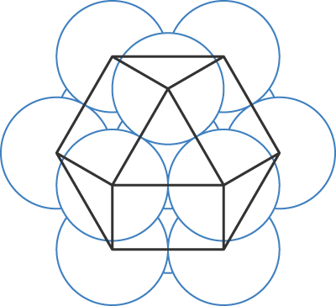
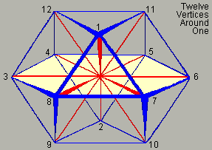
Cuboctahedron
12 spheres fit perfectly around one at the center
Connect their centers to reveal a cuboctahedron
Maximum structure
12 corners the same distance to the center
Buckminster Fuller’s “Dymaxion”

Slide 24
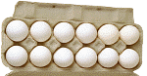
12 has more divisors than other small numbers
So it divides equally
in a the most possible ways
1 2 3 4 5 6 7 8 9 10 11 12
1 1 1 1 1 1 1 1 1 1 1 1
2 3 2 5 2 7 2 3 2 11 2
4 3 4 9 5 3
6 8 10 4
6
12

Slide 25
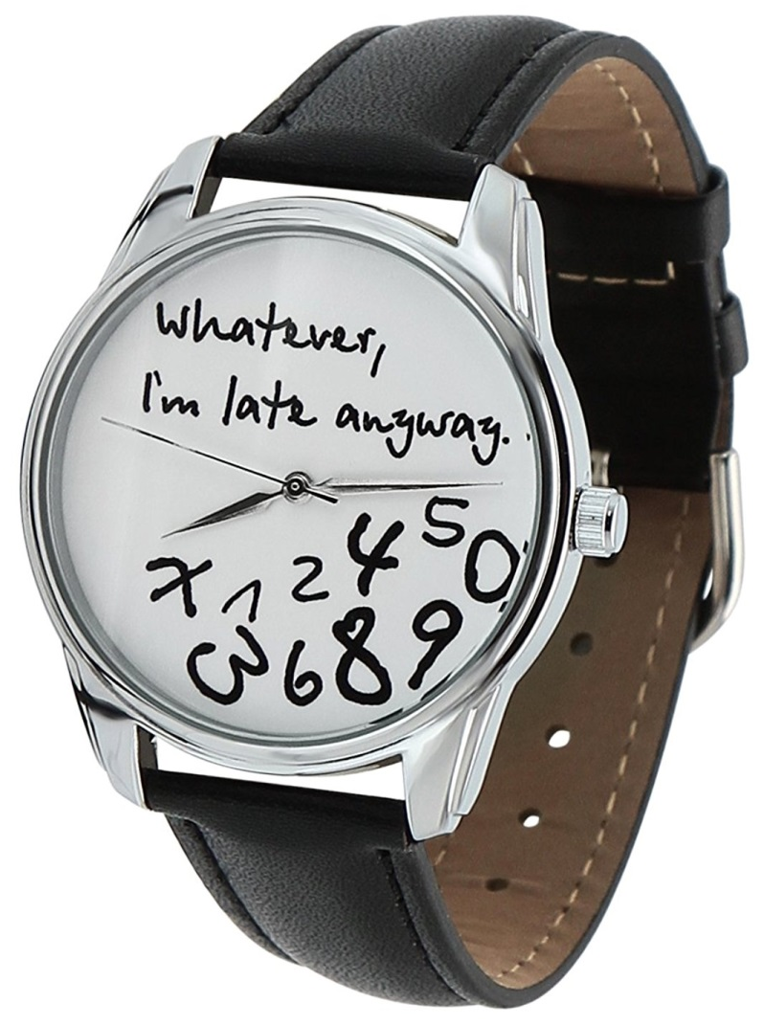
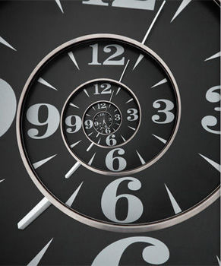
12 x 5 = 60
Introducing 5 allows many more ways to divide an hour
1, 2, 3, 4, 5, 6, 10, 12, 15, 20, 30 , 60
Question: How many seconds are in a year?
Answer: Twelve
January 2nd, February 2nd, March 2nd …

Slide 26
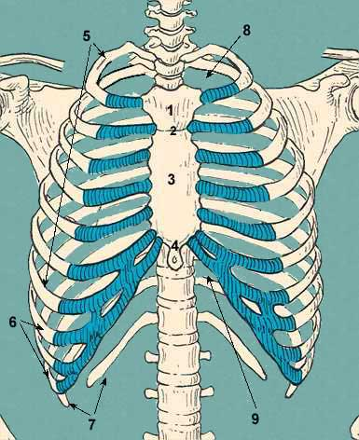
“Structure”
12 Pairs of Ribs

Slide 27
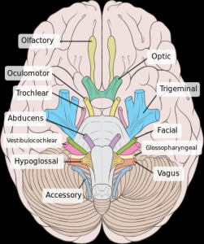
12 pairs of Cranial Nerves
control our head and face

Slide 28

12 meridian lines of Acupuncture
6 in front – Yin
6 in back – Yang
Pathways of Ch’i energy

Slide 29




Greek

Slide 30



Medieval Abbott’s Ring
Weaving
2 hexagons
3 squares
4 triangles
4x3=12
See page 55

Slide 31


Slide 32

12-Around-1
already appears in the construction of the square.

Slide 33

Page 54

Slide 34

Page 56

Slide 35

Grace Cathedral
San Francisco
In the French tradition, like Chartres Cathedral

Slide 36

Rose Window
Grace Cathedral
San Francisco
12 around a center

Slide 37

Rose Window
Grace Cathedral

Slide 38


Slide 39


Slide 40


Slide 41


Slide 42




Slide 43



Homework 8 or 12?

Slide 45



Octagon floor tiles combine with squares to completely cover an area

Slide 46


Slide 47

Where is the initial square?

Slide 48


Slide 49


Slide 50


